Slide 1
Behavior Driven Development
Letting the Business Write your Tests using Cucumber and Gherkin

Slide 2
Behavior Driven Development - BDD
Methodology that allows the business analyst to talk to the developer using Given-When-Then scenarios
Like TDD except you specify “Given-When-Then” behaviors instead of tests
Business requirements written by business become unit tests
Uses Gherkin language for implementation
Cucumber framework for:
Java
JavaScript
Python
.Net
etc etc etc

Slide 3
Discovery Workshop
Short, frequent meetings…
between business and IT…
to discuss features (user stories).
Aka “Three Amigo” meetings. (Business, Development, Testing)
Discuss concrete examples,
produce specs…
before coding – TDD style.
Expose ambiguities and misunderstandings.
Allows business stakeholders to verify that developers are clear on what to build.

Slide 4
Maven Dependencies
<dependency> <groupId>io.cucumber</groupId> <artifactId>cucumber-java</artifactId> <version>3.0.2</version> <scope>test</scope> </dependency>
<dependency> <groupId>io.cucumber</groupId> <artifactId>cucumber-junit</artifactId> <version>3.0.2</version> <scope>test</scope> </dependency>
Notes:
https://medium.com/@mlvandijk/getting-started-with-cucumber-in-java-a-10-minute-tutorial-586652d2c82

Slide 5
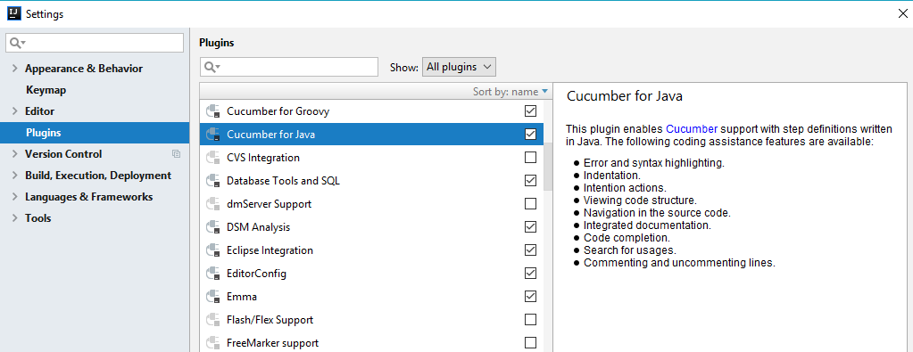
Plugins for all Major IDEs and Build Tools

Slide 6
Features and Scenarios
Cucumber terms:
Feature – A functional user-story of your application
Scenario – Alternate paths within this feature

Slide 7
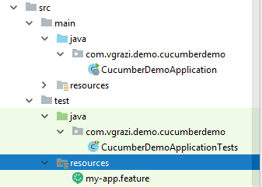
Feature file
Features are stored in “.feature” files in src\test\resources or subdirectories.

Slide 8
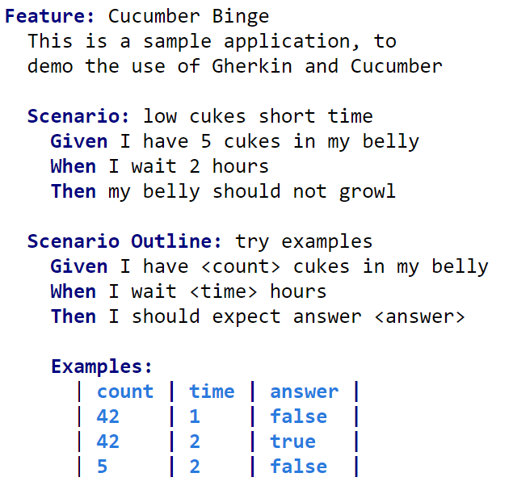
Feature file:
One feature
Many scenarios per file:

Slide 9
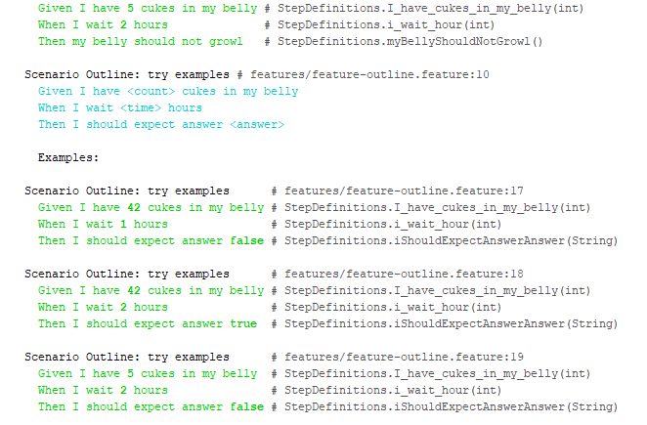

Slide 10
“Ubiquitous Language” | BDD term – The practice of building a common, rigorous language between developers and stakeholders.

Slide 11
Primary keywords:
Feature
Scenario
Steps: Given, And, When, Then, But
Scenario Outline
Examples
Background
Example
Secondary keywords
""" (Doc Strings)
| (Data Tables)
@ (Tags)
# (Comments)

Slide 12
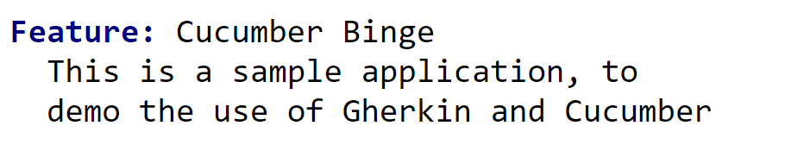
Primary keywords:
Feature
Scenario
Steps: Given, And, When, Then, But
Scenario Outline
Examples
Background
Example
Secondary keywords
""" (Doc Strings)
| (Data Tables)
@ (Tags)
# (Comments)
Feature:
Followed by colon and short text
followed by optional comment description (until “Scenario”)
(Limit one Feature per feature file.

Slide 13
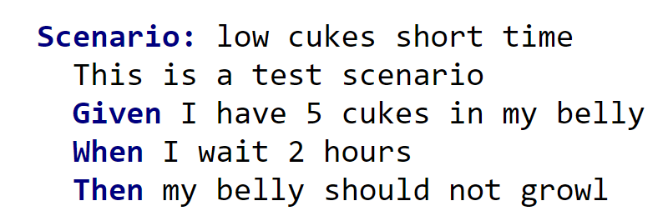
Primary keywords:
Feature
Scenario
Steps: Given, And, When, Then, But
Scenario Outline
Examples
Background
Example
Secondary keywords
""" (Doc Strings)
| (Data Tables)
@ (Tags)
# (Comments)
Scenario:
followed by colon and scenario name
Followed by optional comment description (until “Given”.)

Slide 14
Steps: Given, When, Then, And, But
Given: Initializes the test
Can have multiple “Given”, but use And for clarity
When: Describes the interaction we are testing
Then: Asserts the desired result
But: Additional “Then” steps
Primary keywords:
Feature
Scenario
Steps: Given, And, When, Then, But
Scenario Outline
Examples
Background
Example
Secondary keywords
""" (Doc Strings)
| (Data Tables)
@ (Tags)
# (Comments)

Slide 15
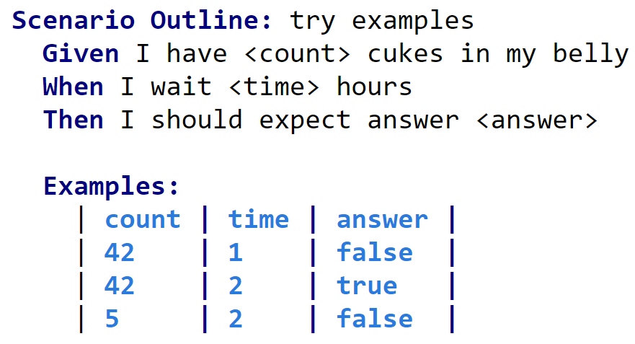
Scenario Outline:
followed by colon and scenario name
Must have “Examples:” section
Refer to Example variables using “<xx> syntax
Primary keywords:
Feature
Scenario
Steps: Given, And, When, Then, But
Scenario Outline
Examples
Background
Example
Secondary keywords
""" (Doc Strings)
| (Data Tables)
@ (Tags)
# (Comments)

Slide 16
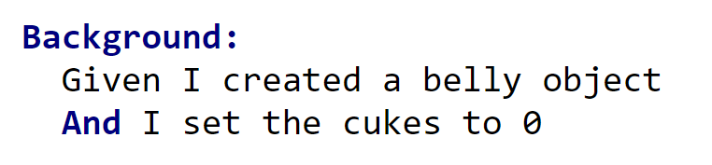
Background
Short “Given” and “And” steps, that execute before each scenario.
Usually include set-up items not focus of business analysts.
(Limit one Background per feature.)
Primary keywords:
Feature
Scenario
Steps: Given, And, When, Then, But
Scenario Outline
Examples
Background
Example
Secondary keywords
""" (Doc Strings)
| (Data Tables)
@ (Tags)
# (Comments)

Slide 17
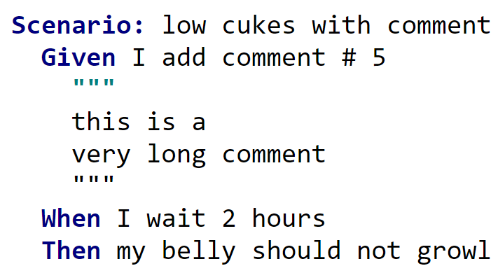
Doc Strings
Used for passing in large blocks of text.
Automatically injected as last parameter in Step definition.
Primary keywords:
Feature
Scenario
Steps: Given, And, When, Then, But
Scenario Outline
Examples
Background
Example
Secondary keywords
""" (Doc Strings)
| (Data Tables)
@ (Tags)
# (Comments)

Slide 18
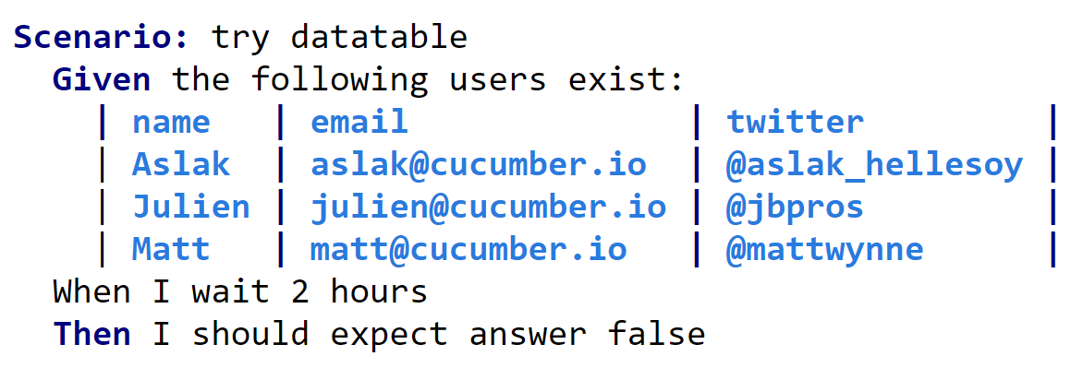
Data Tables
Used for passing in large blocks of data.
Automatically injected as last parameter in Step definition.
Primary keywords:
Feature
Scenario
Steps: Given, And, When, Then, But
Scenario Outline
Examples
Background
Example
Secondary keywords
""" (Doc Strings)
| (Data Tables)
@ (Tags)
# (Comments)

Slide 19
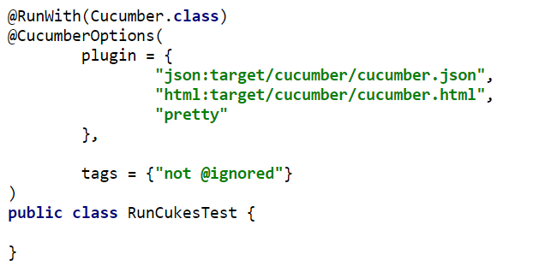
Cucumber Options

Slide 20
Tags
@Tags are used to group tests into run suites
“@Tag1, @Tag2” means Or
“@Tag1”, “@Tag2” means And
Tags can be applied to scenarios, or to entire feature files.

Slide 21
Reduce
Rework
Efficiency
Why BDD?
Effectiveness
Reduce Inventory
Increase Collaboration
Notes:
There are lots of reasons to use BDD – Quality assurance and resilience are the obvious ones, I want to explore 3 distinct advantages that had a profound effects on my teams, witnessed when I was a developer.

Slide 22
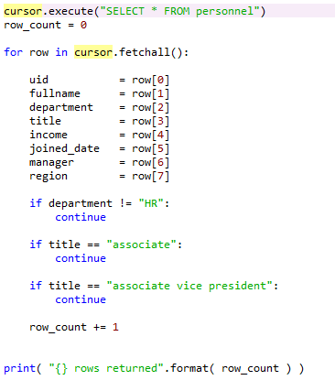
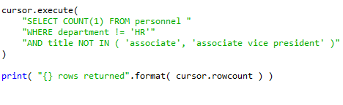
Why BDD – to reduce rework.
We don’t like seeing algorithms like the one on the left, in code
… so why would we permit it in our development lifecycle?
Notes:
Not everywhere captures rework, but they should it’s the biggest Waste.
As developers we know it’s an inefficiency because we avoid it in our code

Slide 23
Why BDD – to reduce rework.
BDD vs. Traditional testing approach.
Notes:
The cost of BDD is up-front – meetings to design tests (and therefore code)
The cost of Gated is quasi-random, viewed by developers as rolling a saving throw against the QA demon.
If BDD is written well, we can automatically integrate the code once the test passes.
The BDD tests then become regression tests.

Slide 24
Why BDD – to reduce inventory.
TDD code coverage provides a metric on developer diligence.
Notes:
TDD is great and coverage is great, promoting good API design, code reuse, economy, etc.
But what about a separate coverage of BDD?

Slide 25
Why BDD – to reduce inventory.
BDD code coverage provides a metric on wasted inventory.
// this isn’t need yet, but …
""" not currently implemented
# functionality to … will need this
/* DEPRECATED! raised Jira-456 to remove */
Notes:
Promises promises – when there’s an initiative to refactor the codebase to increase logging – we’ll waste 30% of our time adding log messages to redundant code!

Slide 26

Why BDD – to increase collaboration.
The three amigos are: Business, Testing and Development (or better yet DevOps).
Notes:
BDD harnesses the effectiveness of an early meeting of the 3 amigos – to ensure the right work gets done and is done well.

Slide 27
Why BDD – to increase collaboration.
The three amigos agree how to proceed, each lending their unique perspective
Is it valuable?
Is it achievable?
Is it
provable?
Notes:
TDD is great and coverage is great, promoting good API design, code reuse, economy, etc.
But what about a separate coverage of BDD?

Slide 28
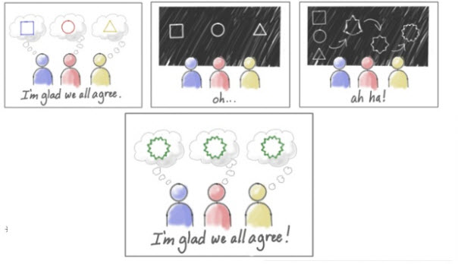
Why BDD – to increase collaboration.
These meetings are more successful and shorter
when there’s a shared language
Notes:
For many reasons misunderstandings can arise when using shared words, we might assume they mean the same thing, when they don’t for this reasons we should aim to use a Ubiquitous Language

Slide 29
Why BDD – to increase collaboration.
How to ensure we have a ubiquitous language
Create a Glossary of terms in a shared location.
Terms defined by business are recommended.
All three amigos contribute to the definitions.
All three amigos review and approve the definitions.
Developers refactor code to use the agreed terms.
Notes:
For many reasons misunderstandings can arise when using shared words, we might assume they mean the same thing, when they don’t for this reasons we should aim to use a Ubiquitous Language

Slide 30
References
https://docs.cucumber.io/guides
Code for this presentation: https://github.com/vgrazi/cucumber-demo

Slide 31
Q&A
Given I attended this presentation
When I listened patiently
Then I had the following questions???

